Slide 1
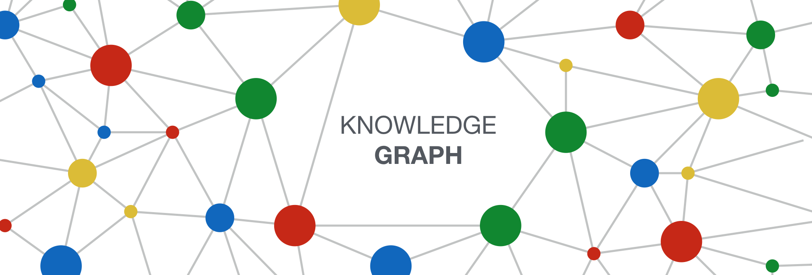
Graph Neural
Named Entity Disambiguation (NED)

Slide 2
Contents
Why this problem?
What is the problem?
What is the state of graph neural NED?
Our approach
What can we do with our approach? (Research question)
How could we answer the research question?
How did we try to answer the question? (Experiment)
What does the answer mean?
What’s next?
Feedback?

Slide 3
Why this problem?
Hybrid methods! Combining machine learning and knowledge representation is interesting
Not just predict using statistics, but incorporate knowledge as well
Already done previous work in named entity recognition and other language understanding tasks
Using machine learning mostly
How does incorporating knowledge help?
Working on making the first named entity disambiguation tool for Icelandic
Applied for 3 year grant in October
got positive answer in February

Slide 4

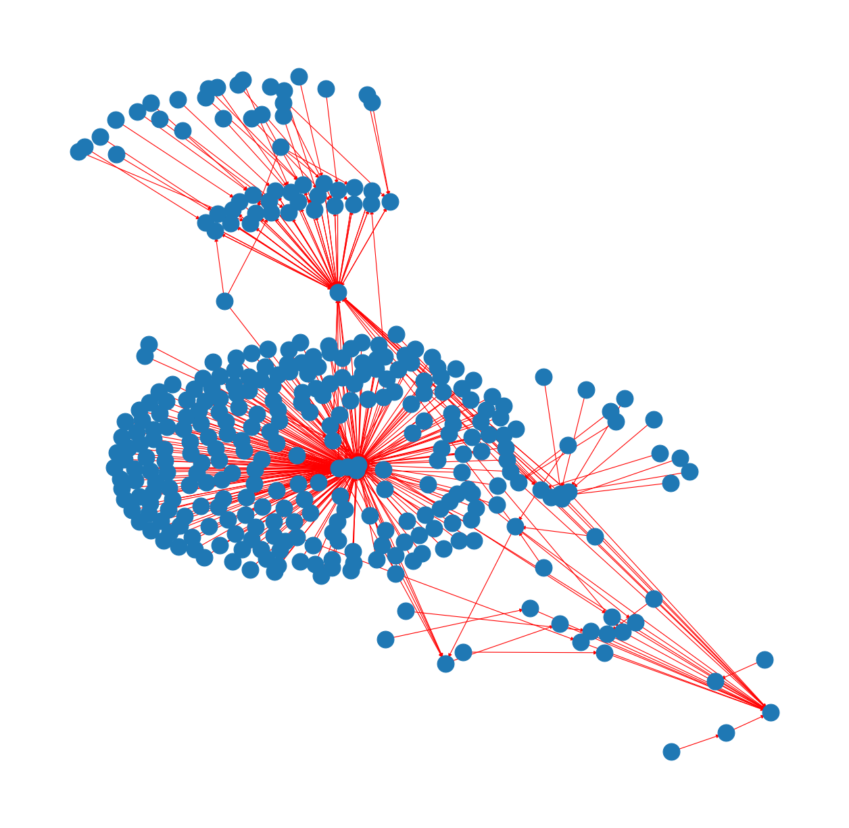
Why this problem?
The goal of NED is to automate some understanding of general knowledge
Bridge between knowledge representation and natural language processing (NLP)
The data is a knowledge graph.
Graphical representation of the world’s knowledge
There has been a revolution in NLP
and simultaneously GNNs are on the rise.

Slide 5
What is the problem?
Definition:
Given a set of entities E (e.g., within a knowledge graph KG) and a set of named entity mentions M within a text document T,
the named entity disambiguation task aims to map each mention m ∈ M to its corresponding entity e ∈ E.
Can be seen as a classification problem:
Which entity in a knowledge graph is consistent with the mention in the text?
Example:
Is it Jordan the country or the athlete?
Or the shoes?
Or the river?
Or one of the 17 other rivers?
Mai the month?
Notes:
An entity exists if it is in the knowledge graph

Slide 6
Why is it interesting and challenging?
Why think about it?
It is a formal way of describing how to give meaning to named objects
Simple enough for the computer to understand
Why solve it?
It’s practical to connect names in text to knowledge about them
Understand what’s being talked about, in order to do something.
First step after named entity recognition
Necessary before further action for some particular name (e.g. connect to software systems).
Semantic web!
Why is it challenging?
Inherent ambiguity in language… in contrast to formal languages
Notes:
An entity exists if it is in the knowledge graph

Slide 7
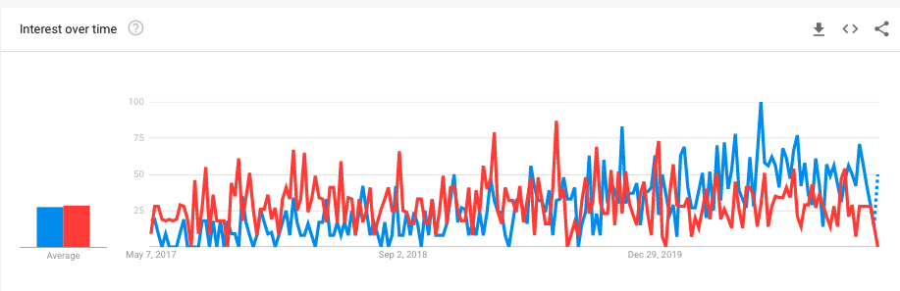
What’s the state of graph neural NED?
Deep Learning NLP
Graph Neural Network
Around 2013, deep neural networks started to change NLP.
In 2018, transfer learning with deep neural networks revolutionised NLP
Pre-trained models, much like what happened in 2015 in computer vision
Until 2018 no studies on a neural approach for entity disambiguation
using graphs as background knowledge.

Slide 8
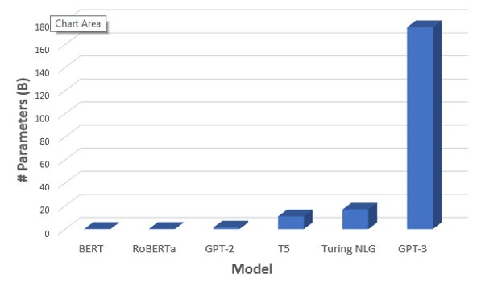
The transfer learning revolution in NLP 2018-
GNNs on the rise
“At the beginning of 2021, I have a feeling that Graph Neural Nets (GNNs) became a buzzword.
As a researcher in this field, I feel a little bit proud to say that I work on this.
It was not always the case: three years ago when I was talking to my peers, who got busy working on GANs and Transformers, the general impression that they got on me was that I was working on exotic niche problems.
Well, the field has matured substantially.”

Slide 9
Three papers on graph neural NED
2018: Named Entity Disambiguation using Deep Learning on Graphs
LSTMs + GCN + static word embeddings
2019: Graph Neural Entity Disambiguation
End-to-end CRF + GCN
2020: Evaluating the Impact of Knowledge Graph Context on Entity Disambiguation Models
Transformers + contextual word embeddings
Notes:
2019 was interesting but had lots of math and no github link

Slide 10
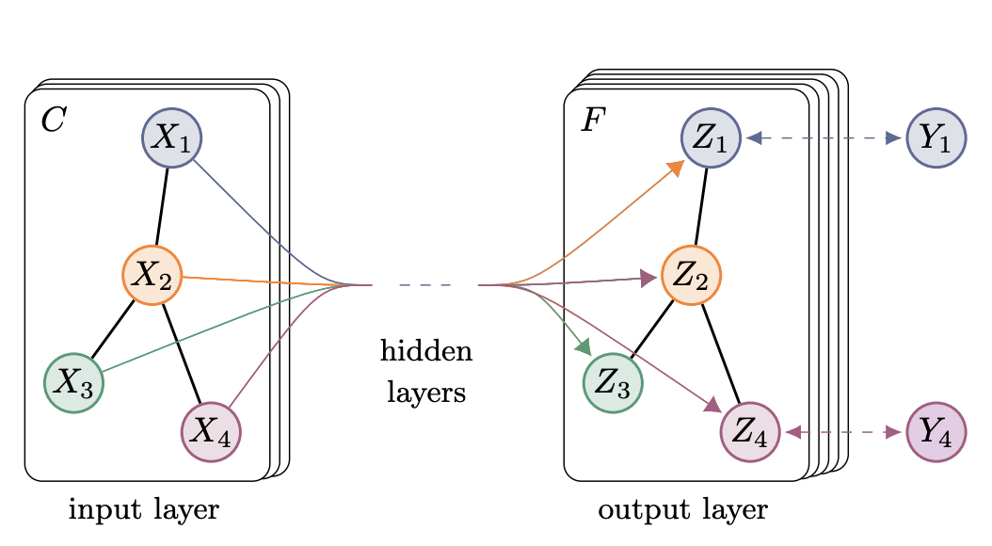
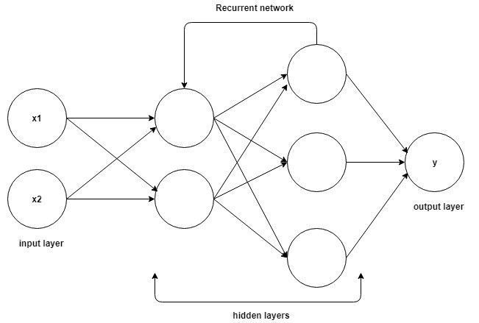
Our approach
Long short term memory network (LSTM), to mine text context
Graph convolutional network (GCN), to mine knowledge context
A final feedforward layer to evaluate if they’re consistent

Slide 11
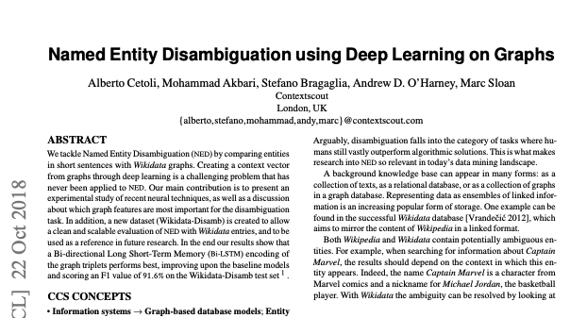
We followed the 2018 paper
Notes:
Wanted to start there and continue to the next
Limited time and energy
Seemed simple enough
Turned out it was kind of crappy

Slide 12
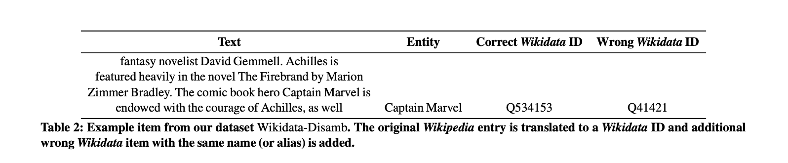
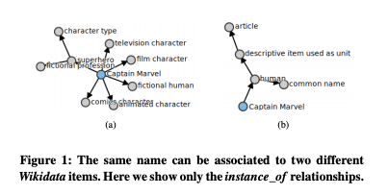
The Wikidata-Disamb dataset
Notes:
Data set has texts
In the text is a name
The name can correspond to different entities in the knowledge graph

Slide 13
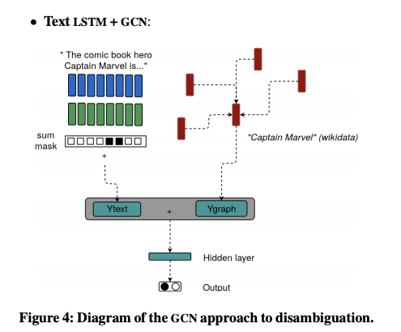
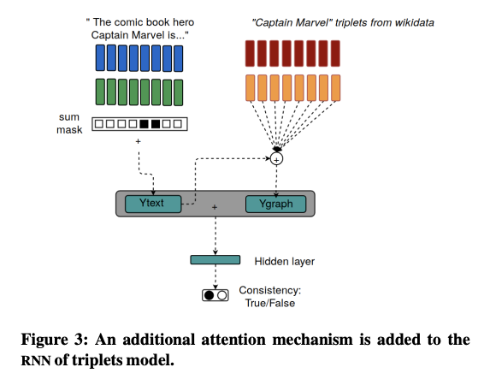
Bird’s eye view of the method: models
Text LSTM + RNN with attention
Text LSTM + GCN with attention

Slide 14
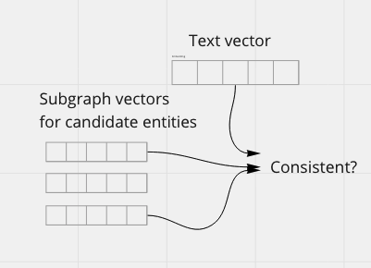
Bird’s eye view of the method:
Text mining + graph mining
The method has three components:
a natural language understanding model that extracts signals from the text
a graph mining model that extracts signals from subgraphs of the KG
a consistency unit, that determines whether the text vector and KG subgraph are consistent
Notes:
Which entity in the knowledge graph is most consistent with the text?
If the news contain concepts related to sports, close in the KG, then it’s likely Michael Jordan
If the news contain concepts related to politics, then it’s the country

Slide 15
Text mining component
The text needs to be represented as a vector.
Different types of models for extracting signals from the text:
LSTM
GCN over graph representation of text
Transformer models
Different vector embeddings for the text:
Static word embeddings
Word2vec
contextual word embeddings
Transformers
pre-trained entity embeddings
Wikipedia2vec
Notes:
Describe lstms in one sentence

Slide 16
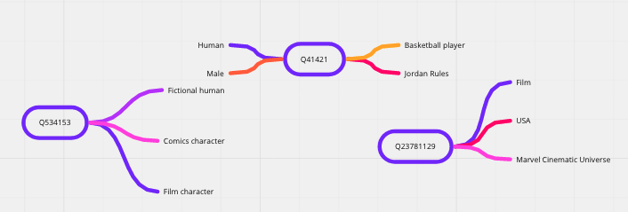
Graph mining component
The subgraph for each candidate needs to be represented as a vector.
Different types of models for extracting signals from the knowledge graph
GCN
RNN
Transformer language models
Different graph embeddings
Like different word embeddings

Slide 17
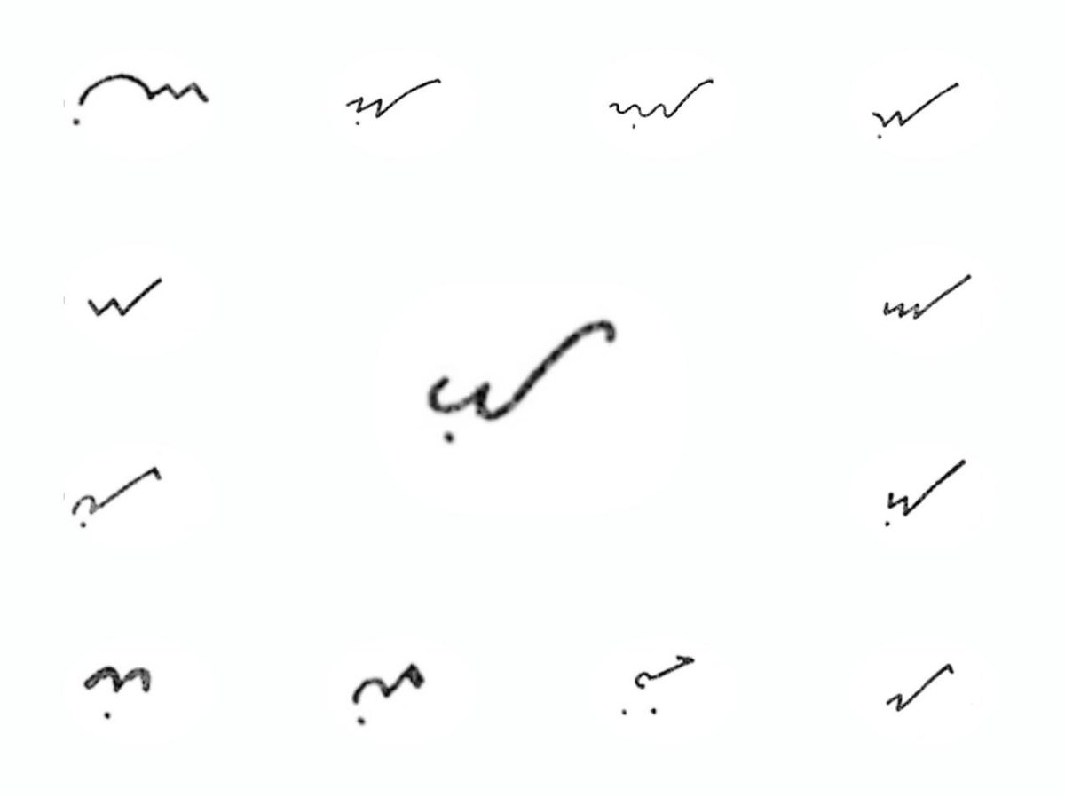

Questions?

Slide 18
What can we do, using our approach?
Basic question:
How important is the knowledge graph context,
compared to the context in the text?
Answerable version of the question:
Is there a positive correlation between the number of nodes in an entity’s subgraph and accuracy metrics?
Notes:
Was curious about this question from the start
Found this middle ground between the different papers’ RQs to partially answer it
Similar to the question from the transformers paper, but about GCN instead. Seemed more fitting

Slide 19
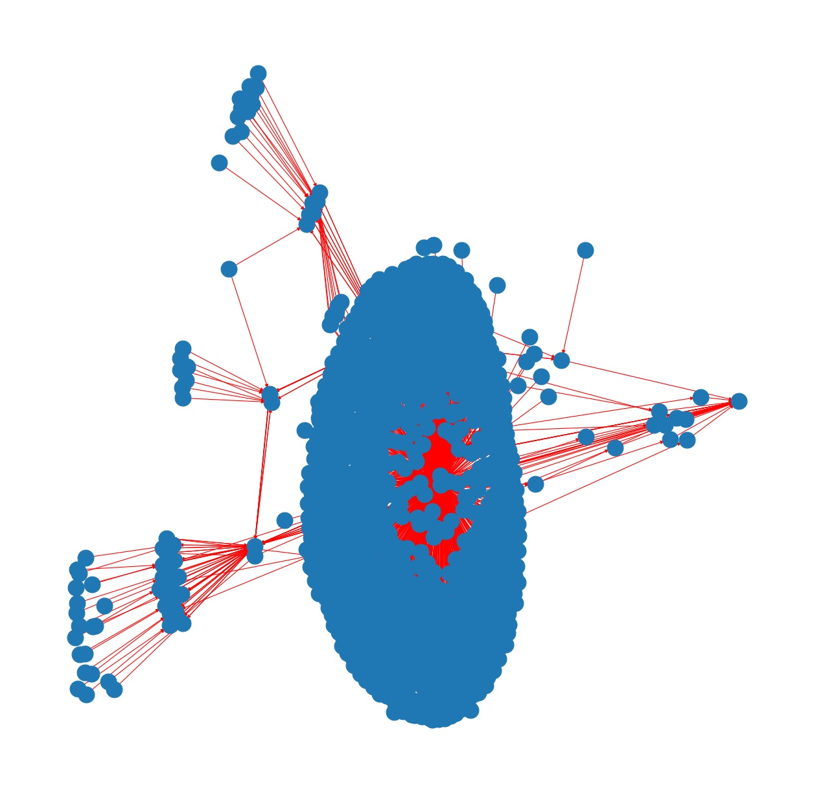
How can we answer the question?
How important is the knowledge graph context,
compared to the context in the text?

Slide 20
Experiments - ideas
How important is the knowledge graph context, compared to the textual context?
Remove part of the text context (shorter text) and see how accuracy varies
Remove part of the knowledge graph context (smaller subgraph) and see how accuracy varies
Change parts of the architecture (models, embedding methods, …)

Slide 21
Experiments - what’s feasible?
Limitations:
Time, Space, Compute
To get real and reliable results, we would need to rent GPUs.
?
?
How important is the knowledge graph context, compared to the textual context?
Is there a positive correlation between the number of nodes in an entity’s subgraph and accuracy metrics?

Slide 22
Different amount of knowledge graph context
Is there a positive correlation between the number of nodes in an entity’s subgraph and accuracy metrics?
Which relations between entities are used?
(Michael Jordan, is_instance_of, basketball player)
(Michael Jordan, has_child, Marcus Jordan)
How many hops in the graph, away from the entity’s node are allowed?
Fan-out
Height
Limit the number of nodes in subgraph at a certain maximum value

Slide 23
How did we try to answer the question?
Easily controlled parameters:
Maximum number of nodes in subgraphs
retrieved when querying the Wikidata API for the subgraph
Types of models
RNN, GCN
Only started running proper experiments at end of February!
Notes:
Didn’t wanna rent a GPU (burned myself on that)

Slide 24

Experiments - challenges faced
Reverse engineered undocumented and deprecated code
For models and for data
Old Tensorflow
Used basic python libraries instead of data science libraries
Data constructed weirdly
Querying badly programmed and didn’t respect the API

Slide 25
Experiment setup
Is there a positive correlation between
the number of nodes in the subgraph
and accuracy metrics?
2 models (RNN with attention, GCN with attention),
3 knowledge subgraph sizes
10 nodes, 100 nodes, 400 nodes
6 training sets, 6 test sets.
Trained on 5000 entities.
Tested on 1000, separate entities.
A correct and incorrect answer for each entity.
Notes:
Small data set

Slide 26
Results - RNN with attention
Knowledge graph size | Precision | Recall | F-1
Trained and tested on max 10 nodes in entity subgraph | 50.5% | 24.7% | 33.2%
Trained on max 100, tested on max 10 | 67% | 59% | 63%
Trained on max 100, tested on max 100 | 91.8% | 87.8% | 89.7%
Trained on max 400, tested on max 10 | 87.2% | 91.0% | 89.1%
Trained on max 400, tested on max 100 | 87.6% | 91.6% | 89.8%
Trained on max 400, tested on max 400 | 87.7% | 92.2% | 89.6%

Slide 27
Results - GCN
Knowledge graph size | Precision | Recall | F-1
Trained and tested on max 10 nodes in entity subgraph | 88.5 | 96.9 | 92.5
Trained on max 100, tested on max 100 | 90.8 | 92.0 | 91.4
Trained on max 400, tested on max 400 | 83.7 | 88.7 | 86.1

Slide 28
Interpreting the results
Is there a positive correlation between
the number of nodes in subgraph
and accuracy metrics?
What does the answer to the research question mean?
Having only a 10 node subgraph for context was bad
Accuracy increases with amount of graph context
Having 100 vs 400 nodes doesn't change much
The model trained on 100 node subgraphs performed best when tested on 100 node subgraphs
The model trained on 400 node subgraphs performed best when tested on 400 node subgraphs
This will be in the report

Slide 29
Limitations of GNNs for the entity linking task
Topology of graph doesn’t matter so much for knowledge?
RNN performed better than GCN, according to the paper
Computing on graphs costs time and energy
More than just on Euclidean sequences
Fewer subgraphs are needed for transformers
They are GNNs!

Slide 30
Lessons learned
Got overview of the problem
Practiced research workflow
Formulating questions, finding ways to answer them with data
Discovered questions to answer
If github repository looks sketchy, stay away!

Slide 31
What next?
Finish what’s left of the experiment, and write into the report.
Construct the subgraphs for the entities more wisely?
Selecting features
Map out plausible research questions and find dependencies
What’s the goal?
Train specifically on rare entities and on common/important entities?
Humans pay attention to what matters
Who cares about London the band?
Quantify importance
(Berlin, Germany more important than Berlin, New Hampshire)
Use transformer models, on different data sets!

Slide 32
More questions found - vary the models
Would a powerful text mining model suffice?
How accurate would the tests be without incorporating the KG at all?
Testable with GPT-3. Should work for common entities
Can a transformer model approach be enhanced using GNNs?
Use e.g. a GCN as graph mining component, instead of approximating the graph with the transformer.
Hypothesis: GNN part can help with cases where the text is ambiguous and you really need knowledge
Which architectural components from the papers reviewed could be combined together, into a more powerful combo?

Slide 33
More questions found - vary the data
What’s the difference between performance on rare and common entities?
Humans don’t think about the band London
For which data points does the LSTM+GCN fail but a transformer doesn’t?
For which data points does having context from the KG matter?
What are the characteristics of entities where having KG context matters?
Is the subgraph density different if rare?

Slide 34
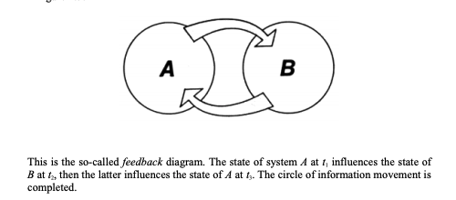
Comments?
Feedback appreciated!

